Slide 1
Neural Networks
Dr. Mehmet Yasin Ulukuş

Slide 2

Artificial Neural Networks
Inspired by the observation very complex webs of interconnected neurons
Individual biological neurons seem to behave in a simple way
But they are organized in a vast network of billions of neurons, each neuron typically connected to thousands of other neurons.
Highly complex computations can be performed by a vast network of fairly simple neurons

Slide 3
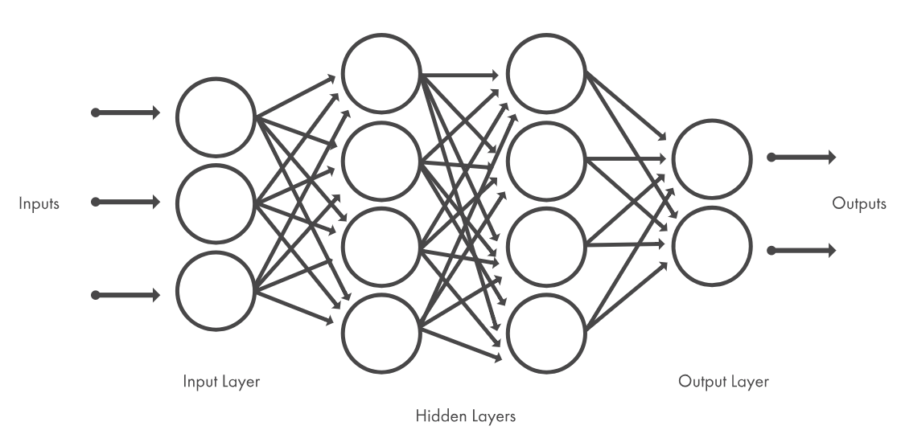
Artificial Neural Networks
Artificial neural networks are built out of a densely interconnected set of simple units
Each unit takes a number of real-valued inputs (possibly the outputs of other units) and produces a single real-valued output (which may become the input to many other units)

Slide 4
Artificial Neural Networks
There has been a great deal of hype surrounding neural networks, making them seem magical and mysterious
They are just nonlinear statistical models
The target function may be discrete-valued, real-valued, or a vector of several real- or discrete-valued attributes
Highly non-linear, i.e., they can produce non-linear regression fits or non-linear decision boundaries
Useful for cases where model intepretation is not important since the weights learned by neural networks are often difficult for humans to interpret
Widely used and highly successful in many application
Speech Recognition
Face Detection
Disease Prediction etc.

Slide 5
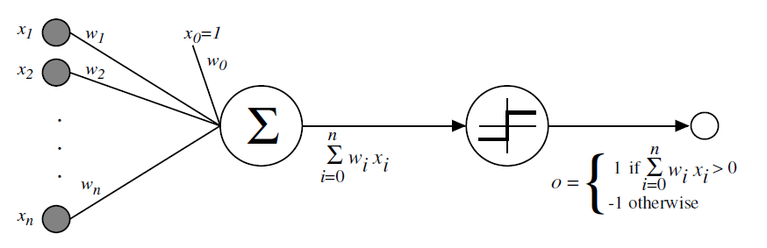
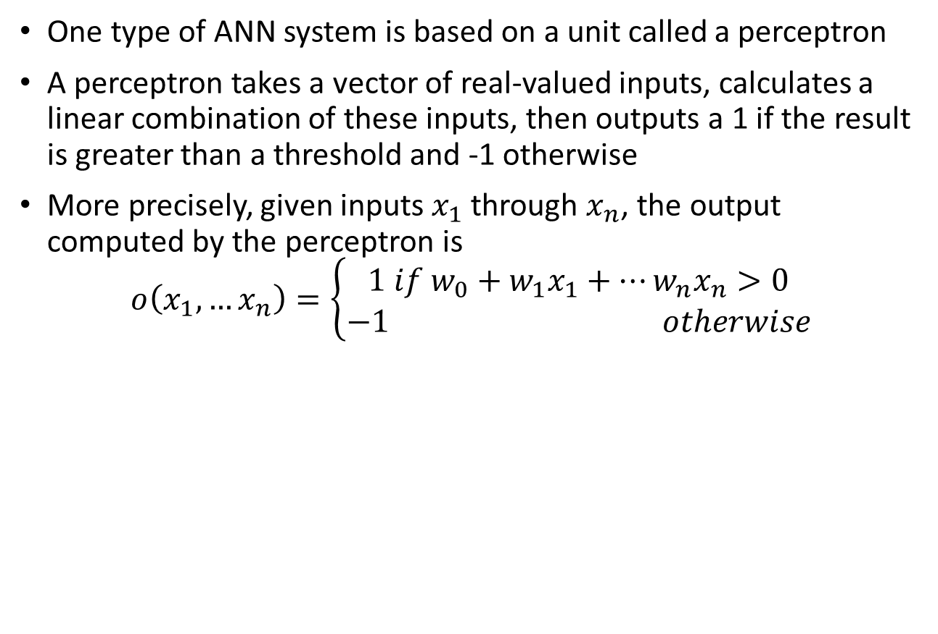
Perceptrons
One type of ANN system is based on a unit called a perceptron
A perceptron takes a vector of real-valued inputs, calculates a linear combination of these inputs, then outputs a 1 if the result is greater than a threshold and -1 otherwise
More precisely, given inputs $x_{1}$ through $x_{n}$, the output computed by the perceptron is
$$o\left(x_{1},…x_{n}\right)=\left\{\begin{aligned}1 if w_{0}+w_{1}x_{1}+…w_{n}x_{n}>0 \\ −1 otherwise\end{aligned}\right.$$

Slide 6
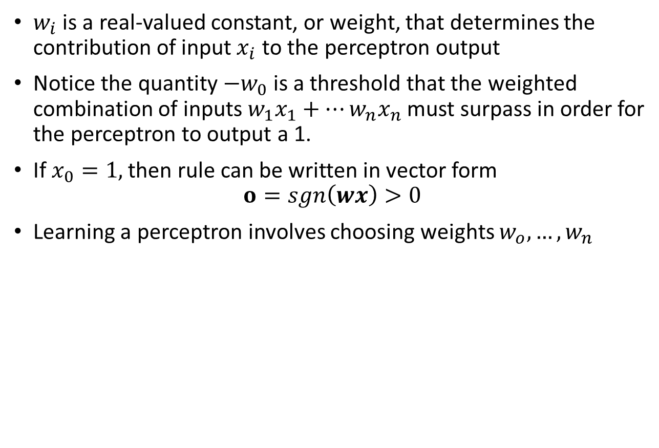
Perceptrons
$w_{i}$ is a real-valued constant, or weight, that determines the contribution of input $x_{i}$ to the perceptron output
Notice the quantity $−w_{0}$ is a threshold that the weighted combination of inputs $w_{1}x_{1}+…w_{n}x_{n}$ must surpass in order for the perceptron to output a 1.
If $x_{0}=1,$ then rule can be written in vector form
$$o=sgn\left(wx\right)>0$$
Learning a perceptron involves choosing weights $w_{o},…,w_{n}$

Slide 7
Perceptrons
We can view the perceptron as representing a hyperplane (linear) decision boundary in the n-dimensional space of instances
The perceptron outputs a 1 for instances lying on one side of the hyperplane and outputs a -1 for instances lying on the other side
They are single layer ANNs, one input layer and one output layer

Slide 8










Perceptrons: Logical Operations
Consider a two input perceptron, can we implement AND and OR operators with a perceptron by finding appropriate weights?
$x_{0}$=1
$$x_{0}=1$$
1.5
-1.5
$$x_{1}$$
1
$$x_{1}$$
1
$$OR(x_{1},x_{2})$$
$$AND(x_{1},x_{2})$$
$$x_{2}$$
1
$$x_{2}$$
1
1
1
-1
1
-1
1
-1
-1
$$x_{1}+x_{2}−1.5$$
$$x_{1}+x_{2}+1.5$$

Slide 9

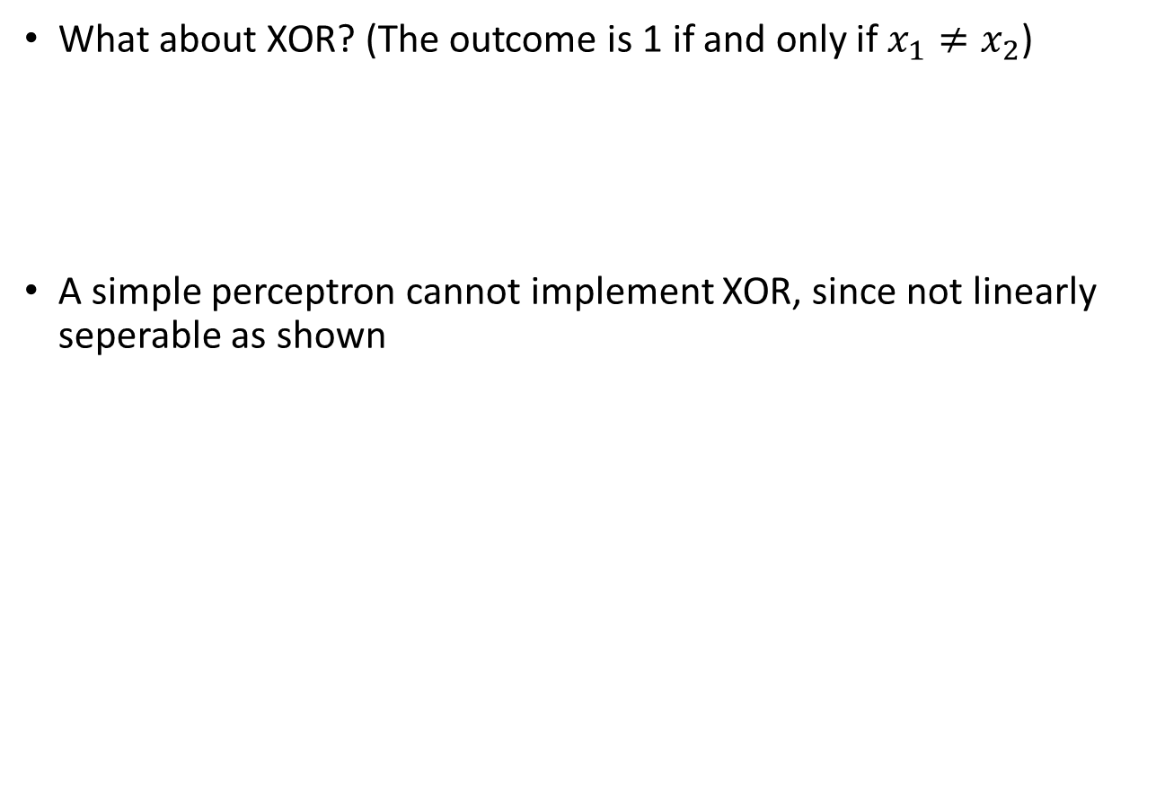



Perceptrons: Logical Operations
What about XOR? (The outcome is 1 if and only if $x_{1}≠x_{2}$)
A simple perceptron cannot implement XOR, since not linearly seperable as shown
$$x_{0}=1$$
$$x_{1}$$
$$XOR(x_{1},x_{2})$$
$$x_{2}$$
1
Not enough! We need a complex network of these perceptrons then
-1
1
-1

Slide 10
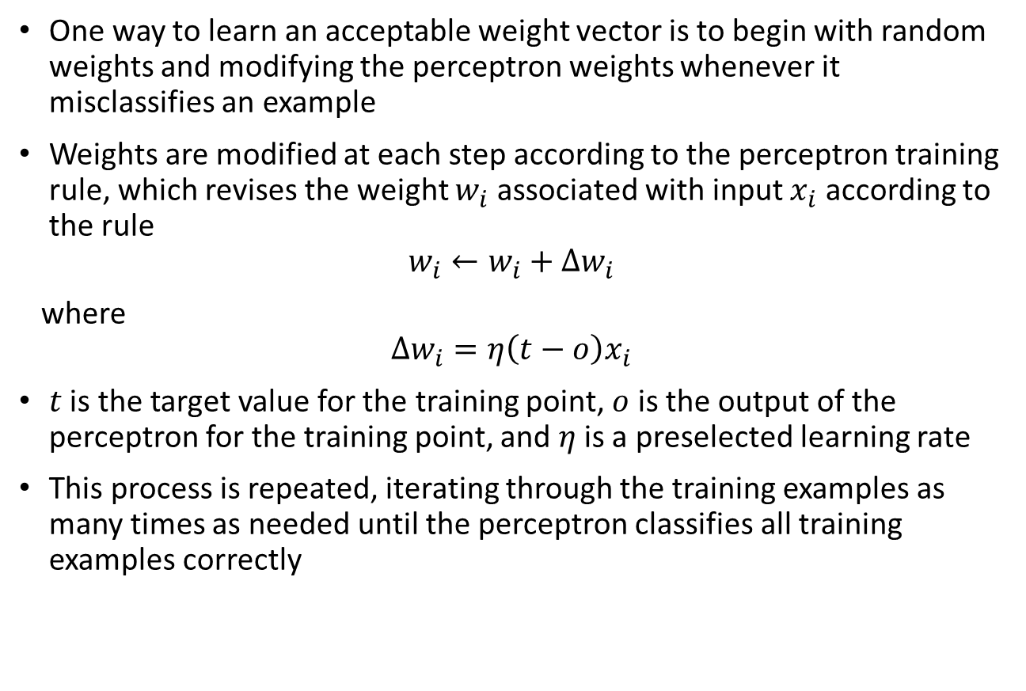
Perceptron Learning Algorithm
One way to learn an acceptable weight vector is to begin with random weights and modifying the perceptron weights whenever it misclassifies an example
Weights are modified at each step according to the perceptron training rule, which revises the weight $w_{i}$ associated with input $x_{i}$ according to the rule
$$w_{i}←w_{i}+Δw_{i}$$
where
$$Δw_{i}=η\left(t−o\right)x_{i}$$
$t$ is the target value for the training point, $o$ is the output of the perceptron for the training point, and $η$ is a preselected learning rate
This process is repeated, iterating through the training examples as many times as needed until the perceptron classifies all training examples correctly

Slide 11
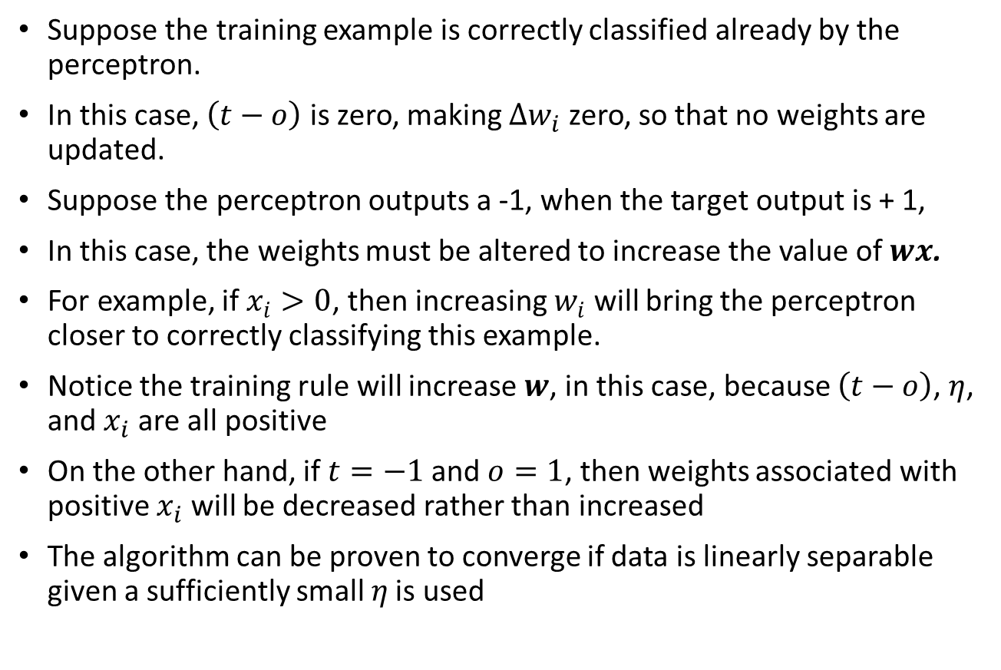
Why does PLA work?
Suppose the training example is correctly classified already by the perceptron.
In this case, $\left(t−o\right)$ is zero, making $Δw_{i}$ zero, so that no weights are updated.
Suppose the perceptron outputs a -1, when the target output is + 1,
In this case, the weights must be altered to increase the value of $wx$.
For example, if $x_{i}>0$, then increasing $w_{i}$ will bring the perceptron closer to correctly classifying this example.
Notice the training rule will increase $w$, in this case, because $\left(t−o\right)$, $η$, and $x_{i}$ are all positive
On the other hand, if $t=−1$and $o=1$, then weights associated with positive $x_{i}$ will be decreased rather than increased
The algorithm can be proven to converge if data is linearly separable given a sufficiently small 𝜂 is used

Slide 12
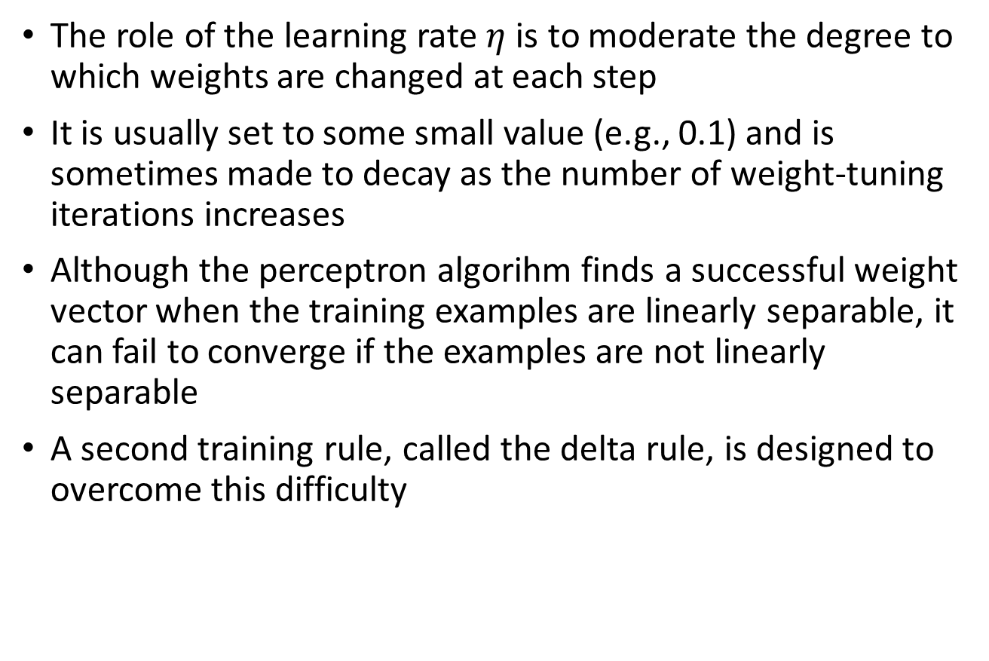
Perceptron Learning Algorithm
The role of the learning rate $η$is to moderate the degree to which weights are changed at each step
It is usually set to some small value (e.g., 0.1) and is sometimes made to decay as the number of weight-tuning iterations increases
Although the perceptron algorihm finds a successful weight vector when the training examples are linearly separable, it can fail to converge if the examples are not linearly separable
A second training rule, called the delta rule, is designed to overcome this difficulty

Slide 13
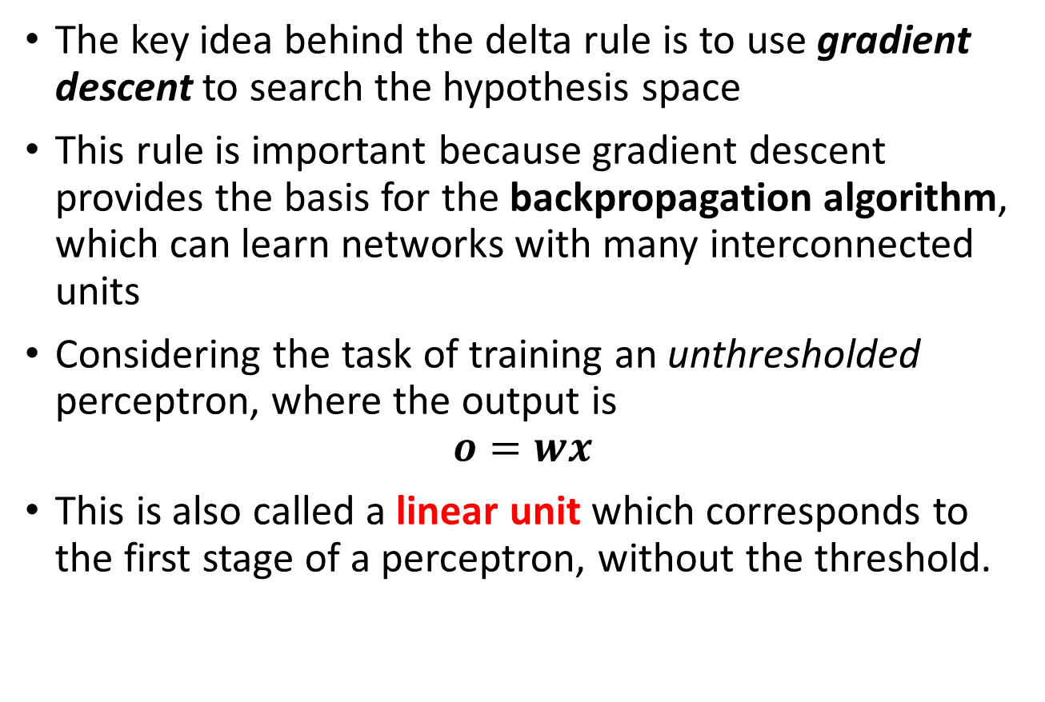
Gradient Descent and Delta Rule
The key idea behind the delta rule is to use gradient descent to search the hypothesis space
This rule is important because gradient descent provides the basis for the backpropagation algorithm, which can learn networks with many interconnected units
Considering the task of training an unthresholded perceptron, where the output is
$$o=wx$$
This is also called a linear unit which corresponds to the first stage of a perceptron, without the threshold.

Slide 14
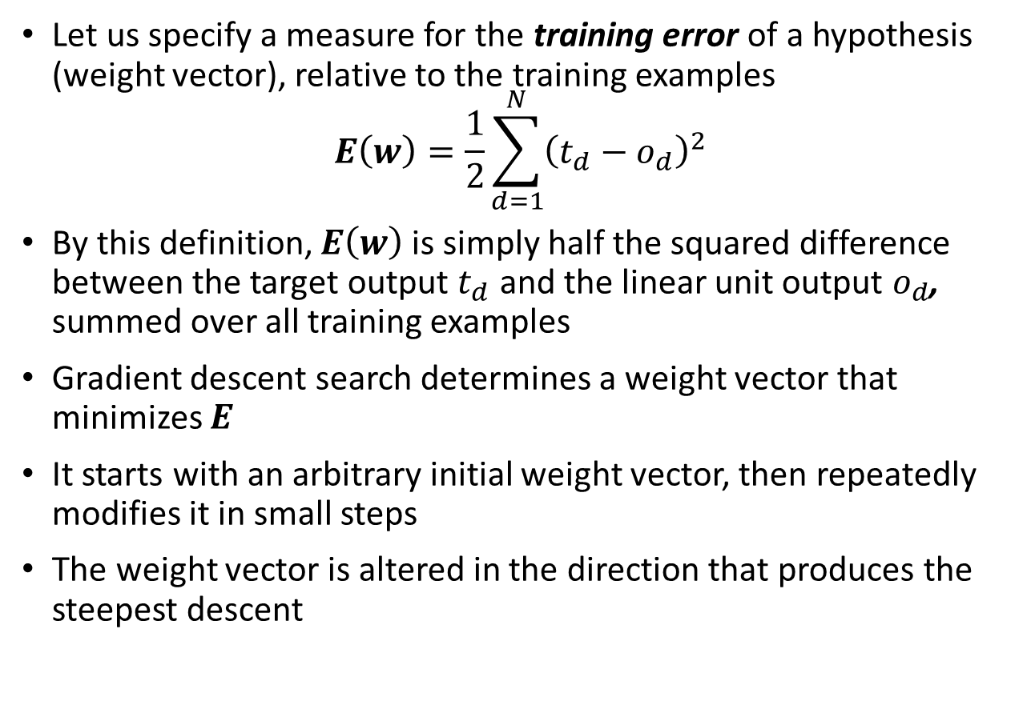
Gradient Descent and Delta Rule
Let us specify a measure for the training error of a hypothesis (weight vector), relative to the training examples
$$E\left(w\right)=\frac{1}{2}\sum_{d=1}^{N}{{\left(t_{d}−o_{d}\right)}^{2}}$$
By this definition, $E\left(w\right)$ is simply half the squared difference between the target output $t_{d}$ and the linear unit output $o_{d}$, summed over all training examples
Gradient descent search determines a weight vector that minimizes $E$
It starts with an arbitrary initial weight vector, then repeatedly modifies it in small steps
The weight vector is altered in the direction that produces the steepest descent

Slide 15
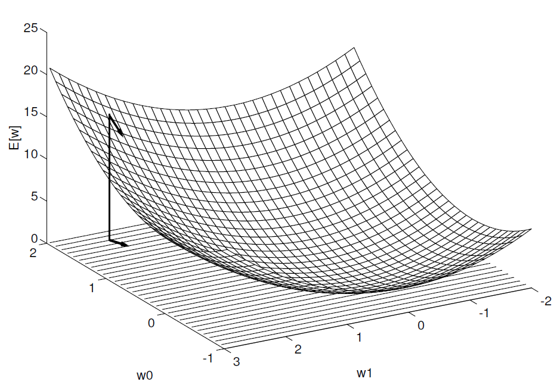
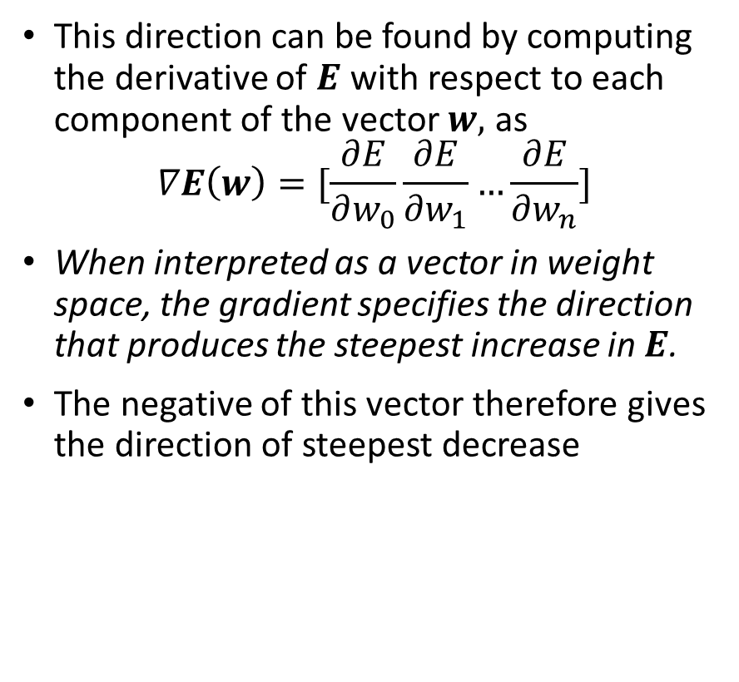
Gradient Descent and Delta Rule
This direction can be found by computing the derivative of $E$ with respect to each component of the vector $w,$ as
$$∇E\left(w\right)=[\frac{∂E}{∂w_{0}}\frac{∂E}{∂w_{1}}…\frac{∂E}{∂w_{n}}]$$
When interpreted as a vector in weight space, the gradient specifies the direction that produces the steepest increase in $E$.
The negative of this vector therefore gives the direction of steepest decrease

Slide 16
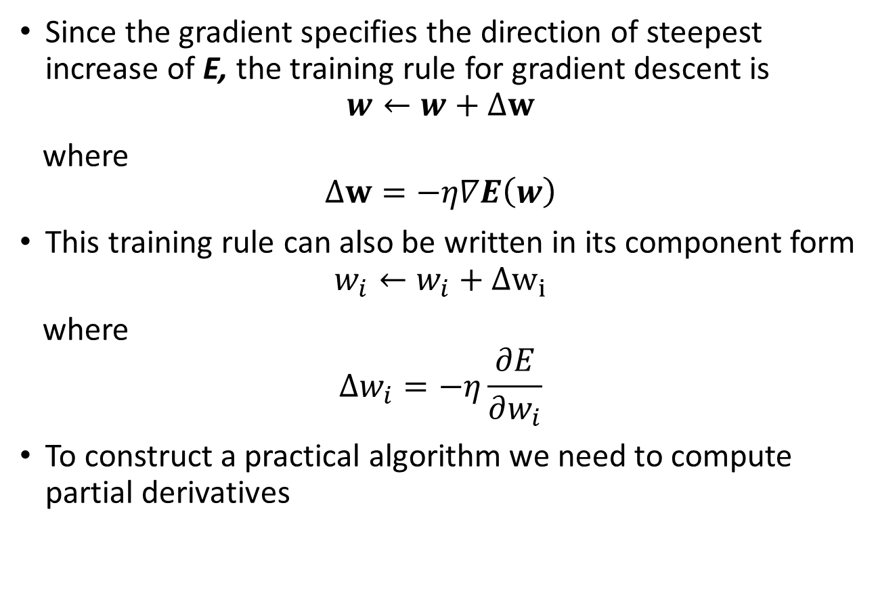
Gradient Descent and Delta Rule
Since the gradient specifies the direction of steepest increase of E, the training rule for gradient descent is
$$w←w+Δw$$
where
$$Δw=−η∇E\left(w\right)$$
This training rule can also be written in its component form
$$w_{i}←w_{i}+Δw_{i}$$
where
$$Δw_{i}=−η\frac{∂E}{∂w_{i}}$$
To construct a practical algorithm we need to compute partial derivatives

Slide 17
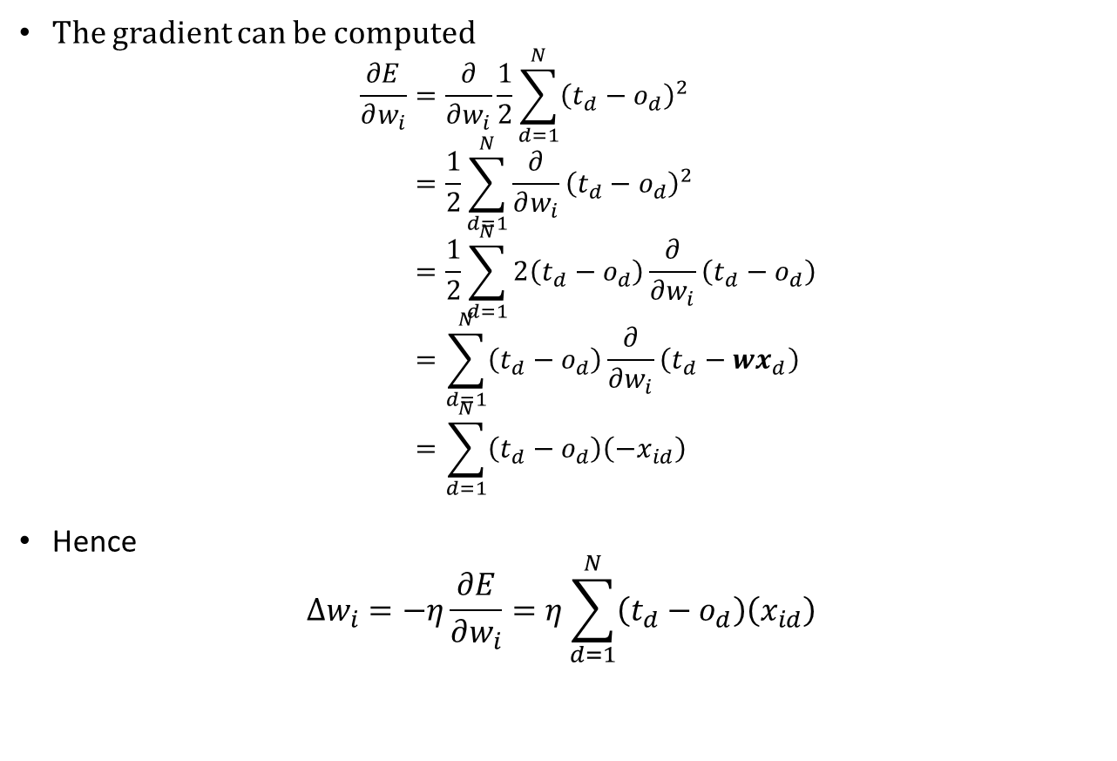
Gradient Descent and Delta Rule
The gradient can be computed
$$\frac{∂E}{∂w_{i}}=\frac{∂}{∂w_{i}}\frac{1}{2}\sum_{d=1}^{N}{{\left(t_{d}−o_{d}\right)}^{2}} \\ =\frac{1}{2}\sum_{d=1}^{N}{\frac{∂}{∂w_{i}}{\left(t_{d}−o_{d}\right)}^{2}} \\ =\frac{1}{2}\sum_{d=1}^{N}{2\left(t_{d}−o_{d}\right)\frac{∂}{∂w_{i}}\left(t_{d}−o_{d}\right)} \\ =\sum_{d=1}^{N}{\left(t_{d}−o_{d}\right)\frac{∂}{∂w_{i}}\left(t_{d}−{wx}_{d}\right)} \\ =\sum_{d=1}^{N}{\left(t_{d}−o_{d}\right)\left(−x_{id}\right)}$$
Hence
$$Δw_{i}=−η\frac{∂E}{∂w_{i}}=η\sum_{d=1}^{N}{\left(t_{d}−o_{d}\right)\left(x_{id}\right)}$$

Slide 18
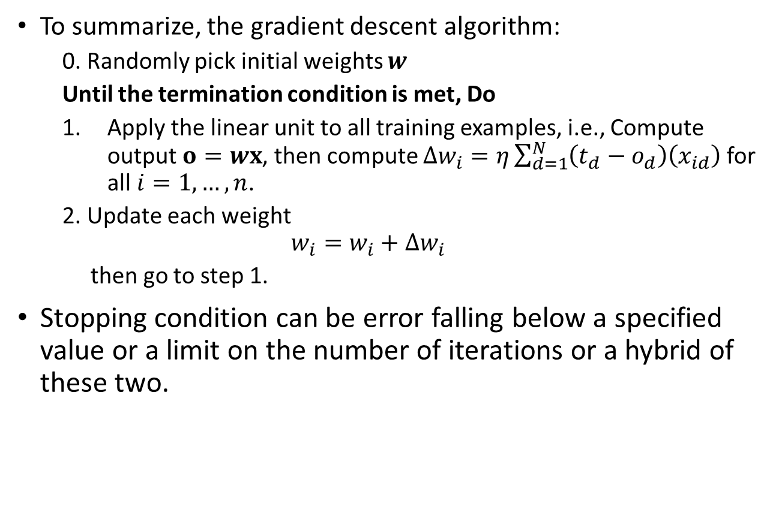
Gradient Descent and Delta Rule
To summarize, the gradient descent algorithm:
0. Randomly pick initial weights $w$
Until the termination condition is met, Do
Apply the linear unit to all training examples, i.e., Compute output $o=wx$, then compute $Δw_{i}=η\sum_{d=1}^{N}{\left(t_{d}−o_{d}\right)\left(x_{id}\right)}$ for all $i=1,…,n$.
2. Update each weight
$$w_{i}=w_{i}+Δw_{i}$$
then go to step 1.
Stopping condition can be error falling below a specified value or a limit on the number of iterations or a hybrid of these two.

Slide 19
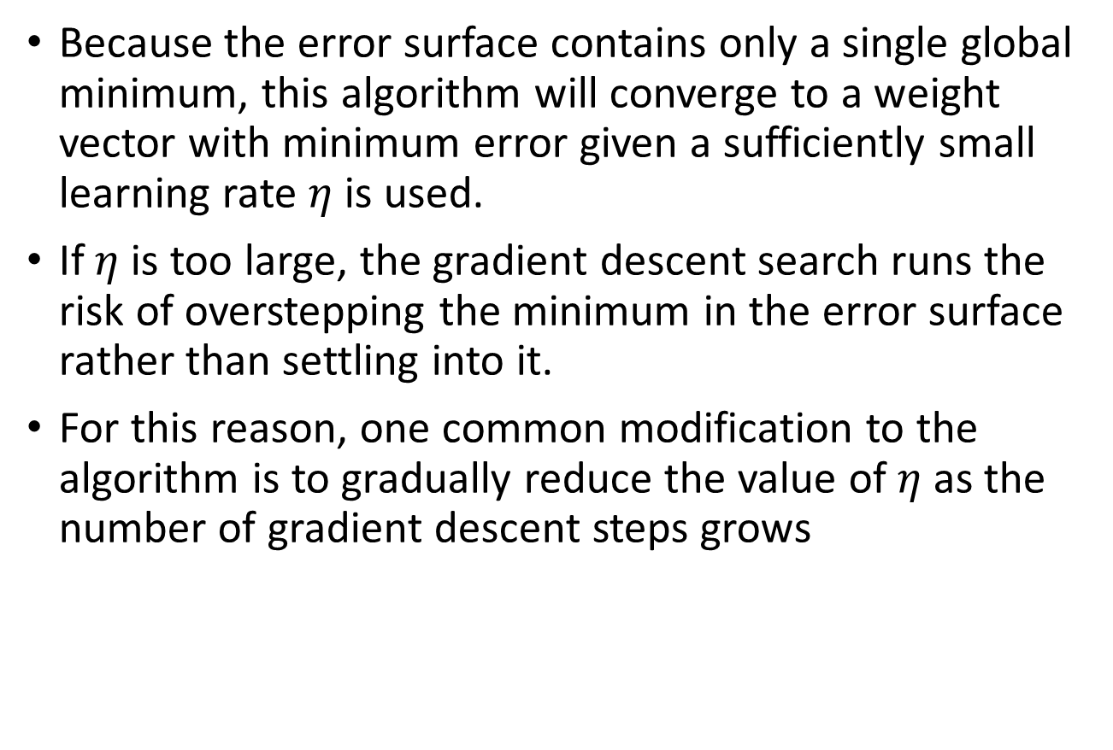
Gradient Descent and Delta Rule
Because the error surface contains only a single global minimum, this algorithm will converge to a weight vector with minimum error given a sufficiently small learning rate $η$ is used.
If $η$is too large, the gradient descent search runs the risk of overstepping the minimum in the error surface rather than settling into it.
For this reason, one common modification to the algorithm is to gradually reduce the value of $η$as the number of gradient descent steps grows

Slide 20
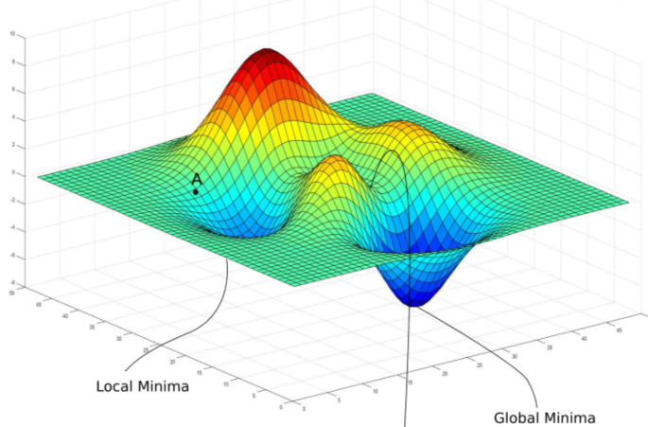
Stochastic Descent
The key practical difficulties in applying gradient descent are
converging to a local minimum can sometimes be quite slow
There is no guarantee that the procedure will find the global minimum when multiple local minima exists
One common variation on gradient descent intended to alleviate these difficulties
Stochastic gradient descent approximates this gradient descent search by updating weights incrementally, following the calculation of the error for each individual example

Slide 21
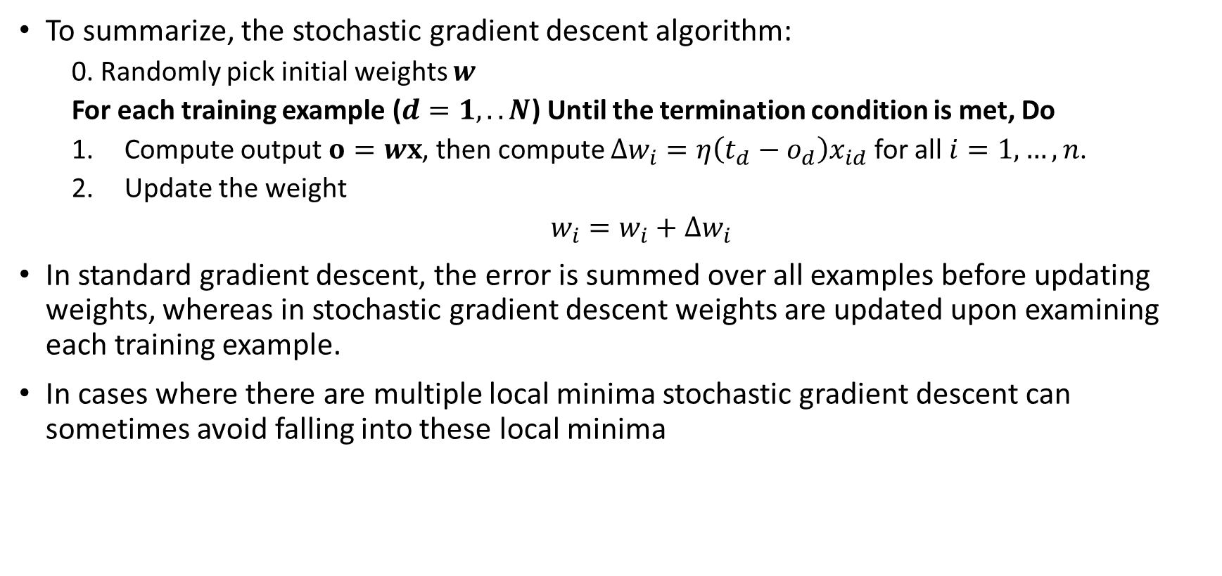
Stochastic Descent
To summarize, the stochastic gradient descent algorithm:
0. Randomly pick initial weights $w$
For each training example ($d=1,..N$) Until the termination condition is met, Do
Compute output $o=wx$, then compute $Δw_{i}=η\left(t_{d}−o_{d}\right)x_{id}$ for all $i=1,…,n$.
2. Update the weight
$w_{i}=w_{i}+Δw_{i}$
In standard gradient descent, the error is summed over all examples before updating weights, whereas in stochastic gradient descent weights are updated upon examining each training example.
In cases where there are multiple local minima stochastic gradient descent can sometimes avoid falling into these local minima

Slide 22




Multilayer Networks
As noted, single perceptrons can only express linear decision surfaces.
Multilayer networks are capable of expressing a rich variety of nonlinear decision boundaries
An MLP is composed of one input layer, one or more layers hidden layers, and one final layer of LTUs called the output
$$∑$$
$$∑$$
$$∑$$
$$∑$$
$$∑$$
$$∑$$
$$∑$$
$$∑$$
$$∑$$
$$∑$$

Slide 23
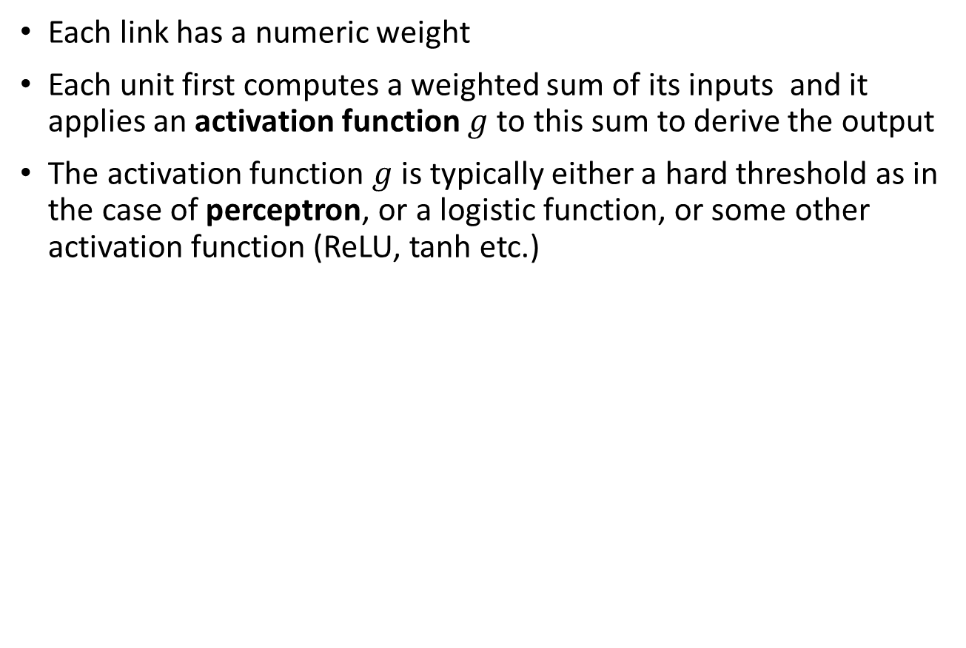
Multilayer Networks
Each link has a numeric weight
Each unit first computes a weighted sum of its inputs and it applies an activation function $g$ to this sum to derive the output
The activation function $g$ is typically either a hard threshold as in the case of perceptron, or a logistic function, or some other activation function (ReLU, tanh etc.)
$$∑$$
$$∑$$
$$∑$$
$$∑$$
$$∑$$
$$∑$$
$$∑$$
$$∑$$
$$∑$$
$$∑$$

Slide 24
Multilayer Networks
A feed-forward network has connections only in one direction—that is, it forms a directed acyclic graph.
Every node receives input from “upstream” nodes and delivers output to “downstream” nodes; there are no loops
A recurrent network, on the other hand, feeds its outputs back into its own inputs
$$∑$$
$$∑$$
$$∑$$
$$∑$$
$$∑$$
$$∑$$
$$∑$$
$$∑$$
$$∑$$
$$∑$$

Slide 25
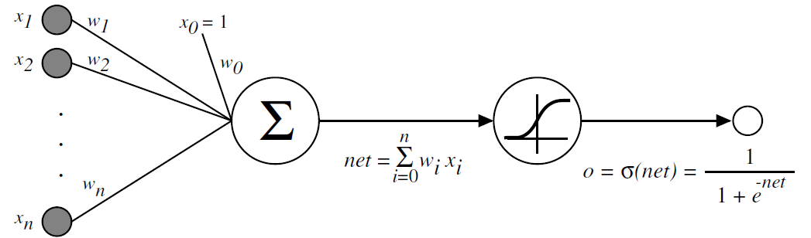
Multilayer Networks: Sigmoid Unit
Multiple layers of cascaded linear units (unthresholded) still produce only linear functions (not suitable for our purpose)
The perceptron unit (hard threshold) has discontinuous threshold makes it indifferentiable
What we need is a unit whose output is a nonlinear function of its inputs, but output is also a differentiable function of its inputs
One solution is a sigmoid unit

Slide 26
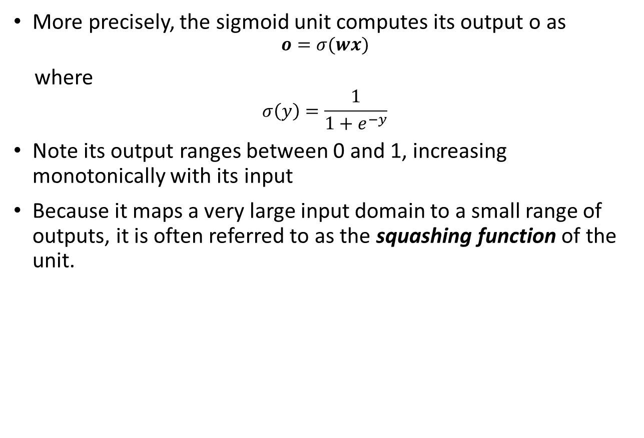
Multilayer Networks: Sigmoid Unit
More precisely, the sigmoid unit computes its output o as
$$o=σ(wx)$$
where
$$σ\left(y\right)=\frac{1}{1+e^{−y}}$$
Note its output ranges between 0 and 1, increasing monotonically with its input
Because it maps a very large input domain to a small range of outputs, it is often referred to as the squashing function of the unit.

Slide 27

Multilayer Networks: Sigmoid Unit
The sigmoid function has the useful property that its derivative is easily expressed in terms of its output
$$\frac{ⅆσ\left(x\right)}{dx}=σ(x)(1−σ(x))$$
We will make use of this property in backpropagation algorithm
The functions $tanh\left(x\right)=2σ\left(2x\right)−1$ and $ReLU\left(x\right)=max⁡(0,x)$ are also commonly used in place of the logistic function

Slide 28
Multilayer Networks: Backpropagation Algorithm
The Backpropagation Algorithm learns the weights for a multilayer network
The algorithm employs gradient descent to attempt to minimize the squared error between the network output values and the target values for these outputs
It first computes the output of every neuron in each consecutive layer (this is the forward pass, just like when making predictions)
Next it measures the error, then goes through each layer in reverse to measure the error contribution from each connection (reverse pass)
Finally slightly tweaks the connection weights to reduce the error (Gradient Descent step)

Slide 29
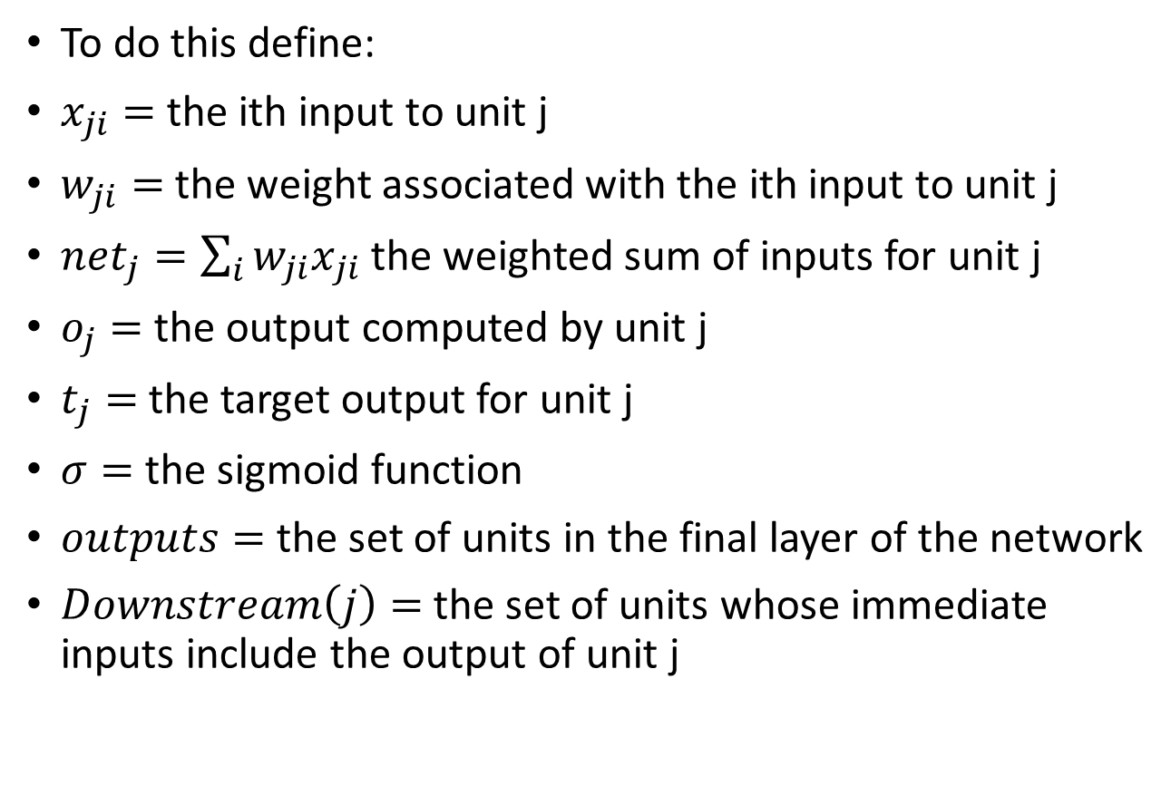
Multilayer Networks: Backpropagation Algorithm
To do this define:
$x_{ji}=$ the ith input to unit j
$w_{ji}=$ the weight associated with the ith input to unit j
$net_{j}=\sum_{i}{w_{ji}x_{ji}}$ the weighted sum of inputs for unit j
$o_{j}=$ the output computed by unit j
$t_{j}=$ the target output for unit j
$σ=$ the sigmoid function
$outputs=$the set of units in the final layer of the network
$Downstream\left(j\right)=$ the set of units whose immediate inputs include the output of unit j

Slide 30
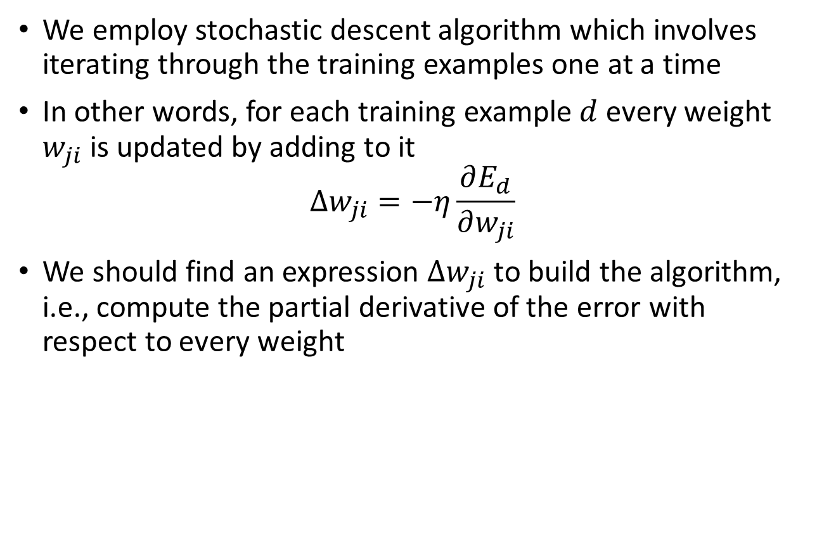
Multilayer Networks: Backpropagation Algorithm
We employ stochastic descent algorithm which involves iterating through the training examples one at a time
In other words, for each training example $d$ every weight $w_{ji}$ is updated by adding to it
$$Δw_{ji}=−η\frac{∂E_{d}}{∂w_{ji}}$$
We should find an expression $Δw_{ji}$ to build the algorithm, i.e., compute the partial derivative of the error with respect to every weight

Slide 31


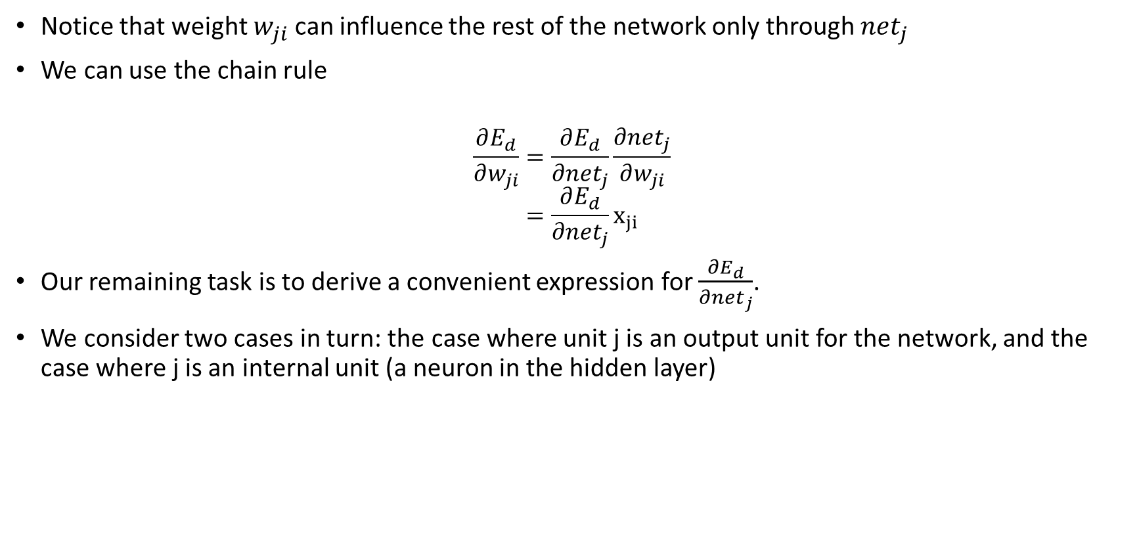
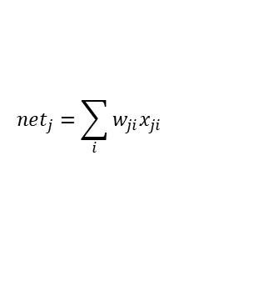




Multilayer Networks: Backpropagation Algorithm
Notice that weight $w_{ji}$ can influence the rest of the network only through $net_{j}$
We can use the chain rule
$$\frac{∂E_{d}}{∂w_{ji}}=\frac{∂E_{d}}{∂net_{j}}\frac{∂net_{j}}{∂w_{ji}} \\ =\frac{∂E_{d}}{∂net_{j}}x_{ji}$$
Our remaining task is to derive a convenient expression for $\frac{∂E_{d}}{∂net_{j}}$.
We consider two cases in turn: the case where unit j is an output unit for the network, and the case where j is an internal unit (a neuron in the hidden layer)
$$net_{j}=\sum_{i}{w_{ji}x_{ji}}$$
$$x_{ji}$$
$$w_{ji}$$
$$∑$$
$$o_{j}=σ\left(net_{j}\right)$$
$$j$$
$$⋮$$
$$⋮$$

Slide 32

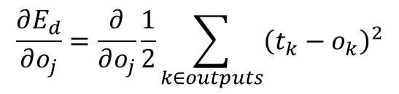
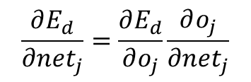
Multilayer Networks: Backpropagation Algorithm
For the output node
We can invoke the chain rule again to write
Consider first term
Since all derivatives are zero for k that is not equal to j, we can drop the summation
$$\frac{∂E_{d}}{∂net_{j}}=\frac{∂E_{d}}{∂o_{j}}\frac{∂o_{j}}{∂net_{j}}$$
$$net_{j}=\sum_{i}{w_{ji}x_{ji}}$$
$$x_{ji}$$
$$w_{ji}$$
$$∑$$
$$o_{j}=σ\left(net_{j}\right)$$
$$j$$
$$\frac{∂E_{d}}{∂o_{j}}=\frac{∂}{∂o_{j}}\frac{1}{2}\sum_{k∈outputs}{{\left(t_{k}−o_{k}\right)}^{2}}$$
$$⋮$$
$$\frac{∂E_{d}}{∂o_{j}}=\frac{∂}{∂o_{j}}\frac{1}{2}{\left(t_{j}−o_{j}\right)}^{2} \\ =−(t_{j}−o_{j})$$

Slide 33
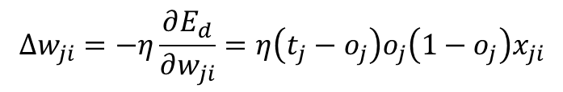

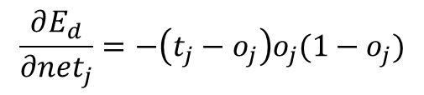
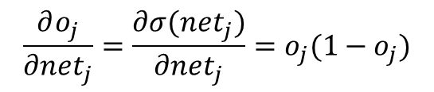
Multilayer Networks: Backpropagation Algorithm
For the output node
Consider the second term
Since the derivative of sigmoid function is $o_{j}(1−o_{j})$
Hence we obtain
We have the stochastic gradient descent rule for output units
$$\frac{∂o_{j}}{∂net_{j}}=\frac{∂σ(net_{j})}{∂net_{j}}=o_{j}(1−o_{j})$$
$$net_{j}=\sum_{i}{w_{ji}x_{ji}}$$
$$x_{ji}$$
$$w_{ji}$$
$$∑$$
$$o_{j}=σ\left(net_{j}\right)$$
$$j$$
$$⋮$$
$$\frac{∂E_{d}}{∂net_{j}}=−\left(t_{j}−o_{j}\right)o_{j}(1−o_{j})$$
$$Δw_{ji}=−η\frac{∂E_{d}}{∂w_{ji}}=η\left(t_{j}−o_{j}\right)o_{j}\left(1−o_{j}\right)x_{ji}$$

Slide 34



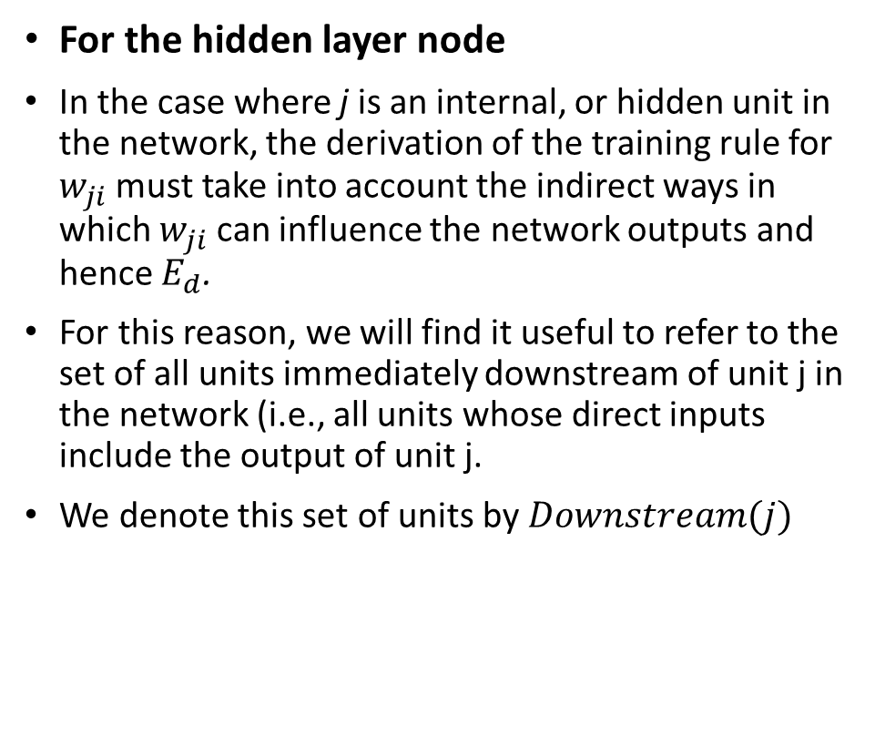
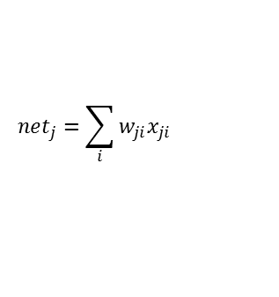




Multilayer Networks: Backpropagation Algorithm
For the hidden layer node
In the case where j is an internal, or hidden unit in the network, the derivation of the training rule for $w_{ji}$ must take into account the indirect ways in which $w_{ji}$ can influence the network outputs and hence $E_{d}$.
For this reason, we will find it useful to refer to the set of all units immediately downstream of unit j in the network (i.e., all units whose direct inputs include the output of unit j.
We denote this set of units by $Downstream(j)$
$$net_{j}=\sum_{i}{w_{ji}x_{ji}}$$
$$x_{ji}$$
$$w_{ji}$$
$$o_{j}=σ\left(net_{j}\right)$$
$$∑$$
$$∑$$
$$j$$
$$w_{kj}$$
$$⋮$$
$$o_{j}=σ\left(net_{j}\right)$$
$$⋮$$
$$∑$$
$$k$$

Slide 35
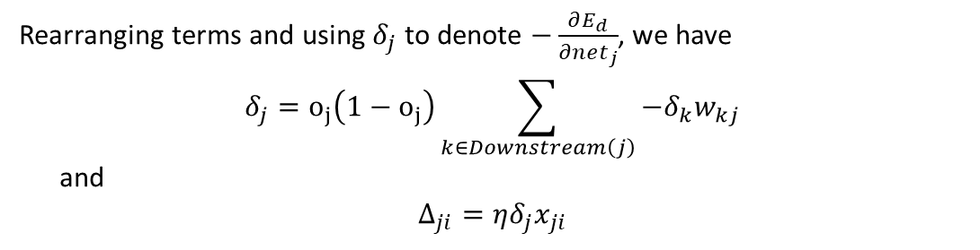
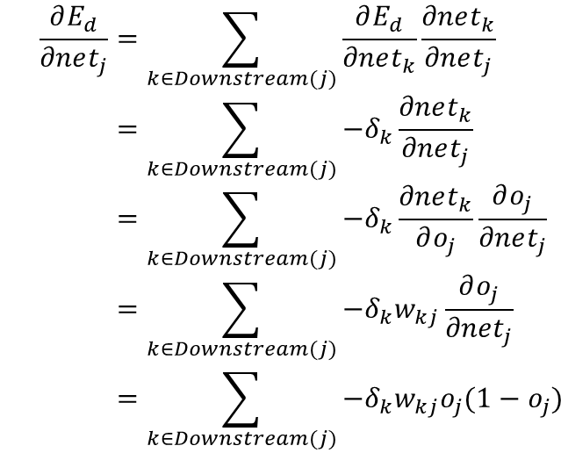
Multilayer Networks: Backpropagation Algorithm
For the hidden layer node, we can write
$$\frac{∂E_{d}}{∂net_{j}}=\sum_{k∈Downstream(j)}{\frac{∂E_{d}}{∂net_{k}}\frac{∂net_{k}}{∂net_{j}}} \\ =\sum_{k∈Downstream(j)}{−δ_{k}\frac{∂net_{k}}{∂net_{j}}} \\ =\sum_{k∈Downstream(j)}{−δ_{k}\frac{∂net_{k}}{∂o_{j}}\frac{∂o_{j}}{∂net_{j}}} \\ =\sum_{k∈Downstream(j)}{−δ_{k}w_{kj}\frac{∂o_{j}}{∂net_{j}}} \\ =\sum_{k∈Downstream(j)}{−δ_{k}w_{kj}o_{j}(1−o_{j})}$$
$$net_{j}=\sum_{i}{w_{ji}x_{ji}}$$
$$x_{ji}$$
$$w_{ji}$$
$$o_{j}=σ\left(net_{j}\right)$$
$$∑$$
$$∑$$
$$j$$
$$w_{kj}$$
$$⋮$$
$$⋮$$
$$o_{j}=σ\left(net_{j}\right)$$
$$∑$$
$$k$$
Rearranging terms and using $δ_{j}$ to denote $−\frac{∂E_{d}}{∂net_{j}}$, we have
$$δ_{j}=o_{j}\left(1−o_{j}\right)\sum_{k∈Downstream\left(j\right)}{−δ_{k}w_{kj}}$$ and
$$Δ_{ji}=ηδ_{j}x_{ji}$$

Slide 36
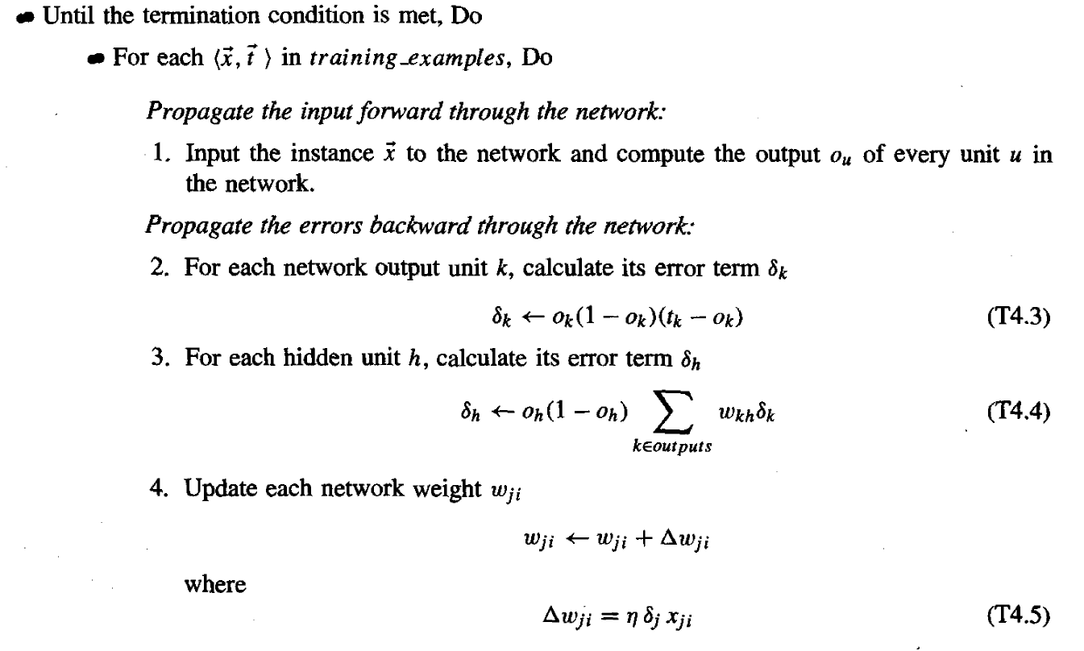
Multilayer Networks: Backpropagation Algorithm
Backpropagation Algorithm for two layers of sigmoid units

Slide 37
Multilayer Networks: Backpropagation Algorithm Stopping
The termination condition for the algorithm has been left unspecified
One obvious choice is to continue training until the error on the training examples falls below some predetermined threshold
This is a poor strategy and may lead to overfitting
One approach, known as weight decay, is to decrease each weight by some small factor during each iteration
This is equivalent to modifying the definition of E to include a penalty term corresponding to the total magnitude of the network weights

Slide 38
Multilayer Networks: Backpropagation Algorithm Stopping
Use validation to overcome this issue
In typical implementations of this approach, two copies of the network weights are kept:
One copy for training and a separate copy of the best-performing weights thus far, measured by their error over the validation set.
Once the trained weights reach a significantly higher error over the validation set than the stored weights, training is terminated

Slide 39
Learning Network Structure
So far, we have considered the problem of learning weights, given a fixed network structure
If we choose a network that is too big, it will be able to memorize all the examples and will not necessarily generalize well to inputs that have not been seen before
Neural networks are subject to overfitting when there are too many parameters in the model
The choices to be made are number of hidden layers and their sizes
The usual approach is to use cross-validation techniques, try different network structures and use the one that gives the minimum validation error
You can use grid search with cross-validation to find the right parameters or may be a randomized search

Slide 40
Learning Network Structure
For many problems you can start with just one or two hidden layers
For more complex problems, you can gradually ramp up the number of hidden layers, until you start overfitting the training set
Don’t forget that you need huge amount of training data to fit a deeper network
You may simply use the same size for all hidden layers, that’s just one hyperparameter to tune instead of one per layer
Just like for the number of layers, you can try increasing the number of neurons gradually until the network starts overfitting

Slide 41
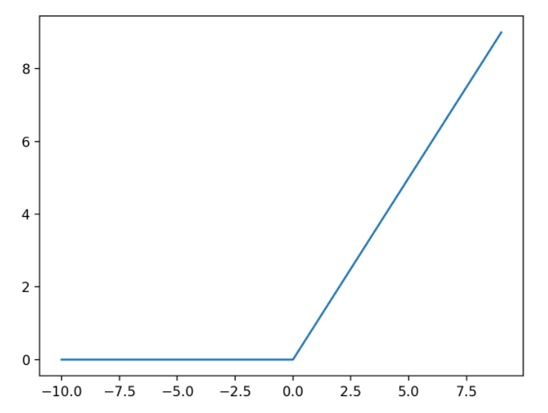

Learning Network Structure
For the output layer, the softmax activation function is generally a good choice for multiclass classification tasks
$$P(Y=i|X)=\frac{e^{z_{i}}}{\sum_{j=1}^{K}{e^{z_{j}}}}$$
For regression tasks, you can simply use no activation function at all
For hidden layers ReLU works generally better than sigmoid

